Slide 1
CAMBRA
Interventions / Treatments

Slide 2
CAMBRA Interventions
Most of these are used to modify the biofilm
Make it less hospitable to acidophilic bacteria
Some also kill bacteria

Slide 3
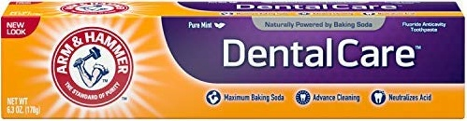
Regular Toothpaste
For LOW and some MODERATE risk patients
Toothpaste is milling paste – most will damage porcelain glaze and composite polish
Anything with an RDA > 80 is too abrasive
Arm & Hammer Complete Care has an RDA of 35 – safe for all restorations
Arm & Hammer also raises the pH of oral environment
Discourages acidophilic (cariogenic) bacteria
Photo from web

Slide 4
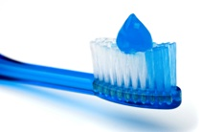
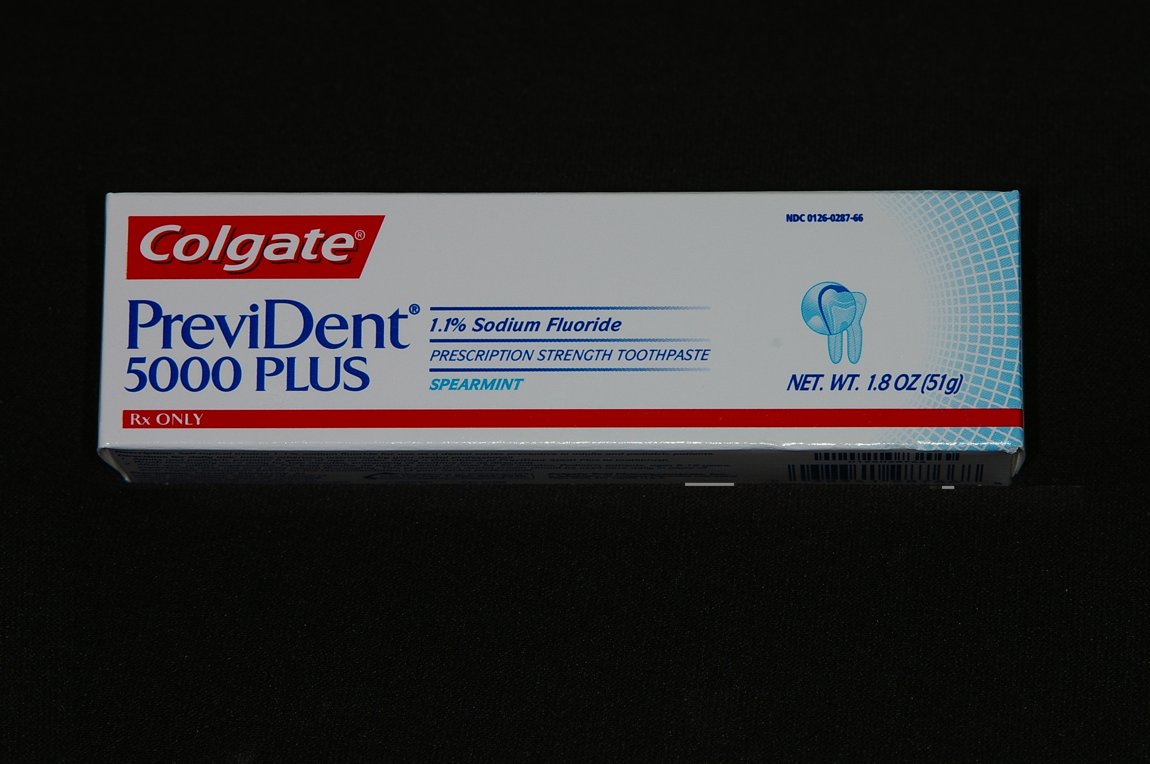
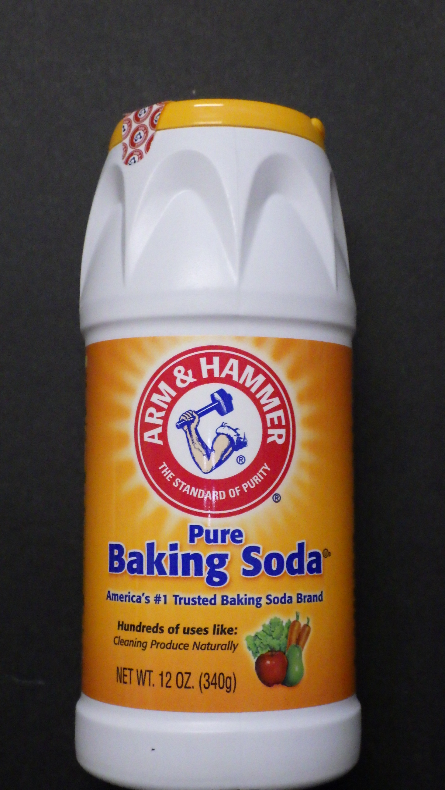
High Fluoride Toothpaste
Pea-size amount
Use baking soda with toothpaste (except Arm&Hammer). Sprinkle it on top of any toothpaste to raise pH.
Colgate Prevident 5000
Photo from web

Slide 5

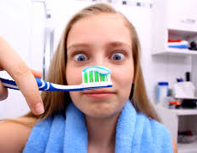
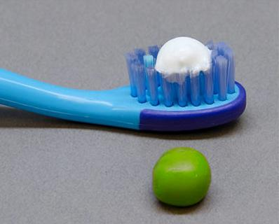
Toothpaste is Milling Paste
too much toothpaste
Pea-size amount
Photo from web

Slide 6
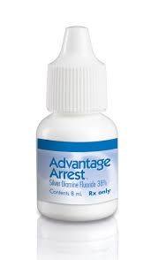
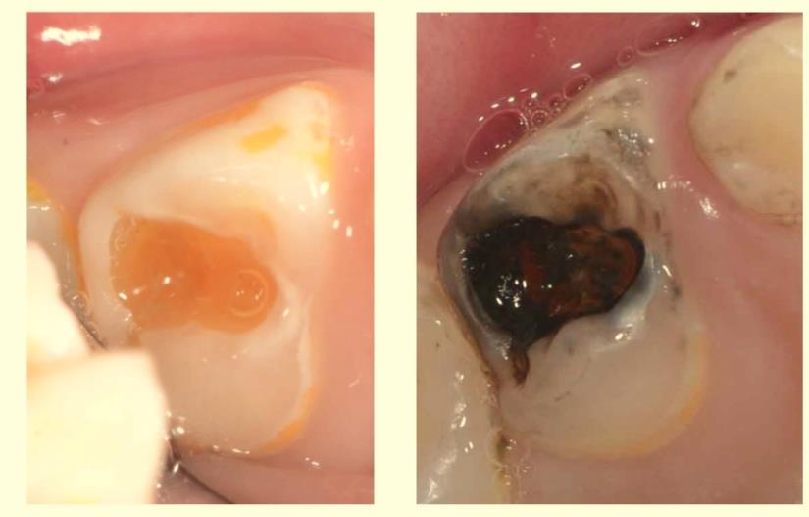
Silver Diamine Fluoride
Photo from web

Slide 7
No Longer “off label”
The FDA granted Advantage Arrest Silver Diamine Fluoride a Breakthrough Therapy Designation on 30 October, 2016
Use to arrest dental caries is no longer considered “off label use”
M.O. Coover, DDS, MAGD

Slide 8
Silver Diamine Fluoride
38% SFD solution contains
Silver ions – 253,870 ppm
Fluoride ions – 44,800 ppm
The high F⁺ concentration can be toxic when swallowed in large amounts
Use only one drop per treatment session and RINSE
Mei, et al; antibacterial effects of silver diamine fluoride
on multi-species cariogenic biofilm on caries
M.O. Coover, DDS, MAGD

Slide 9
Silver Diamine Fluoride
Silver ions inactivate glucosyltransferase enzymes which stops bacterial glucan production
Prevents bacterial adhesion to tooth
Silver is toxic to bacteria
Fluoride ions bind to enolase and ATPase effectively stopping bacterial carbohydrate metabolism of acidogenic oral bacteria
Kills bacteria
Fluoride strengthen enamel by forming fluorapatite
M.O. Coover, DDS, MAGD

Slide 10
Silver Diamine Fluoride
Since ancient times, the silver ion has been known to be effective against a broad range of microorganisms
Interaction of silver ions with thiol groups in enzymes and proteins plays an essential role in its antimicrobial action
Between 2.5 and 5 ppm Ag is toxic to bacteria and human mesenchymal cells
W.K. Jung, et. Al., Appl Environ Microbiol. 2008 Apr; 74(7): 2171–2178
C. Greulich, et.al., RSC Advances, 2012, 2, 6981–6987
M.O. Coover, DDS, MAGD

Slide 11
Effects on Bonding
50% reduction in GIC bond strength but rinsing with water restores bond strength
33% reduction in resin bond strength but again, rinsing restores the bond strength
SDF inhibits matrix metalloproteases in dentin collagen
Knight, et.al., Aust Dent J 2006;51(1):42-45
Mei, et al; antibacterial effects of silver diamine fluoride
on multi-species cariogenic biofilm on caries
M.O. Coover, DDS, MAGD

Slide 12
How to Apply
Allow SDF to soak into and react with the lesion for 1 to 3 minutes.
Then rinse with copious water and either leave exposed or cover with GIC
M.O. Coover, DDS, MAGD

Slide 13
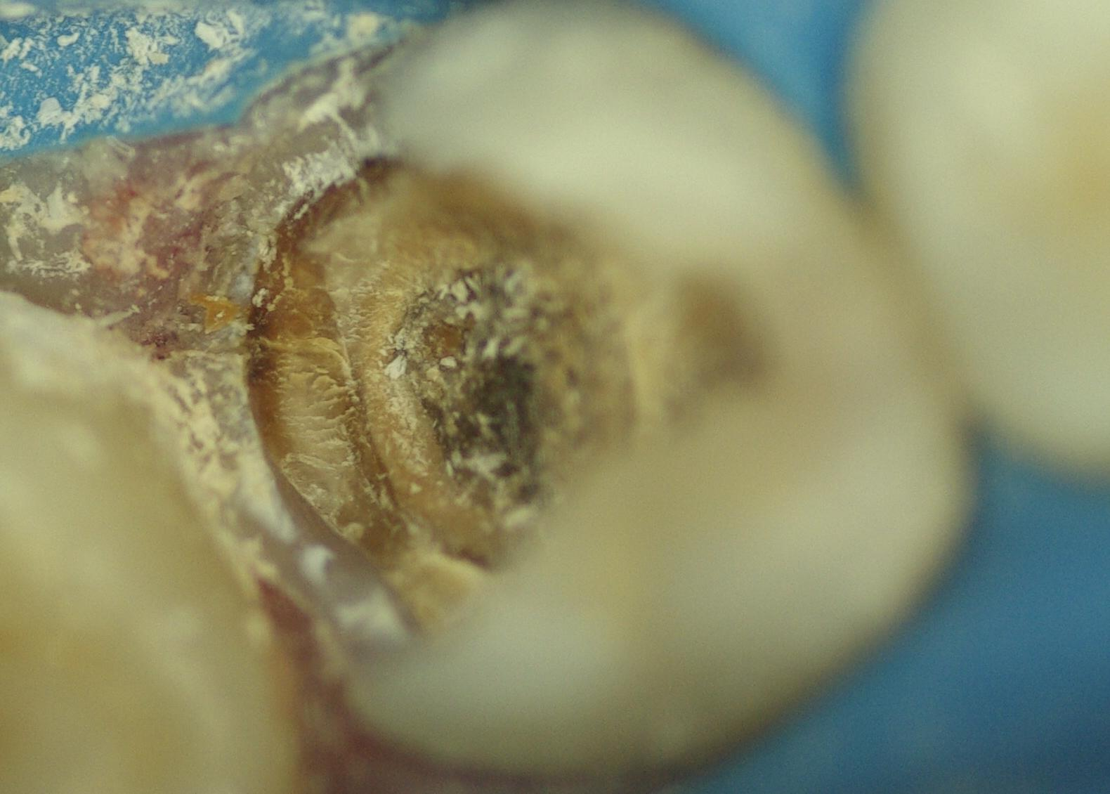
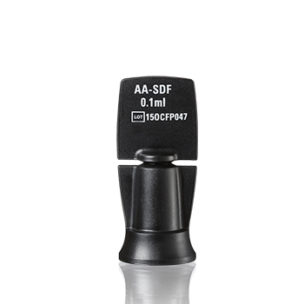
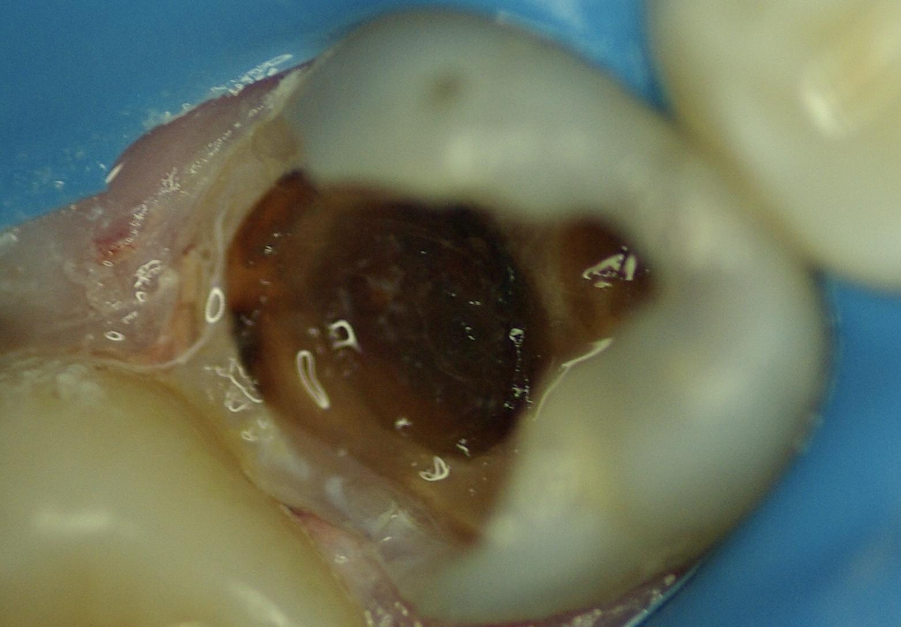
SDF in Action
M.O. Coover, DDS, MAGD

Slide 14
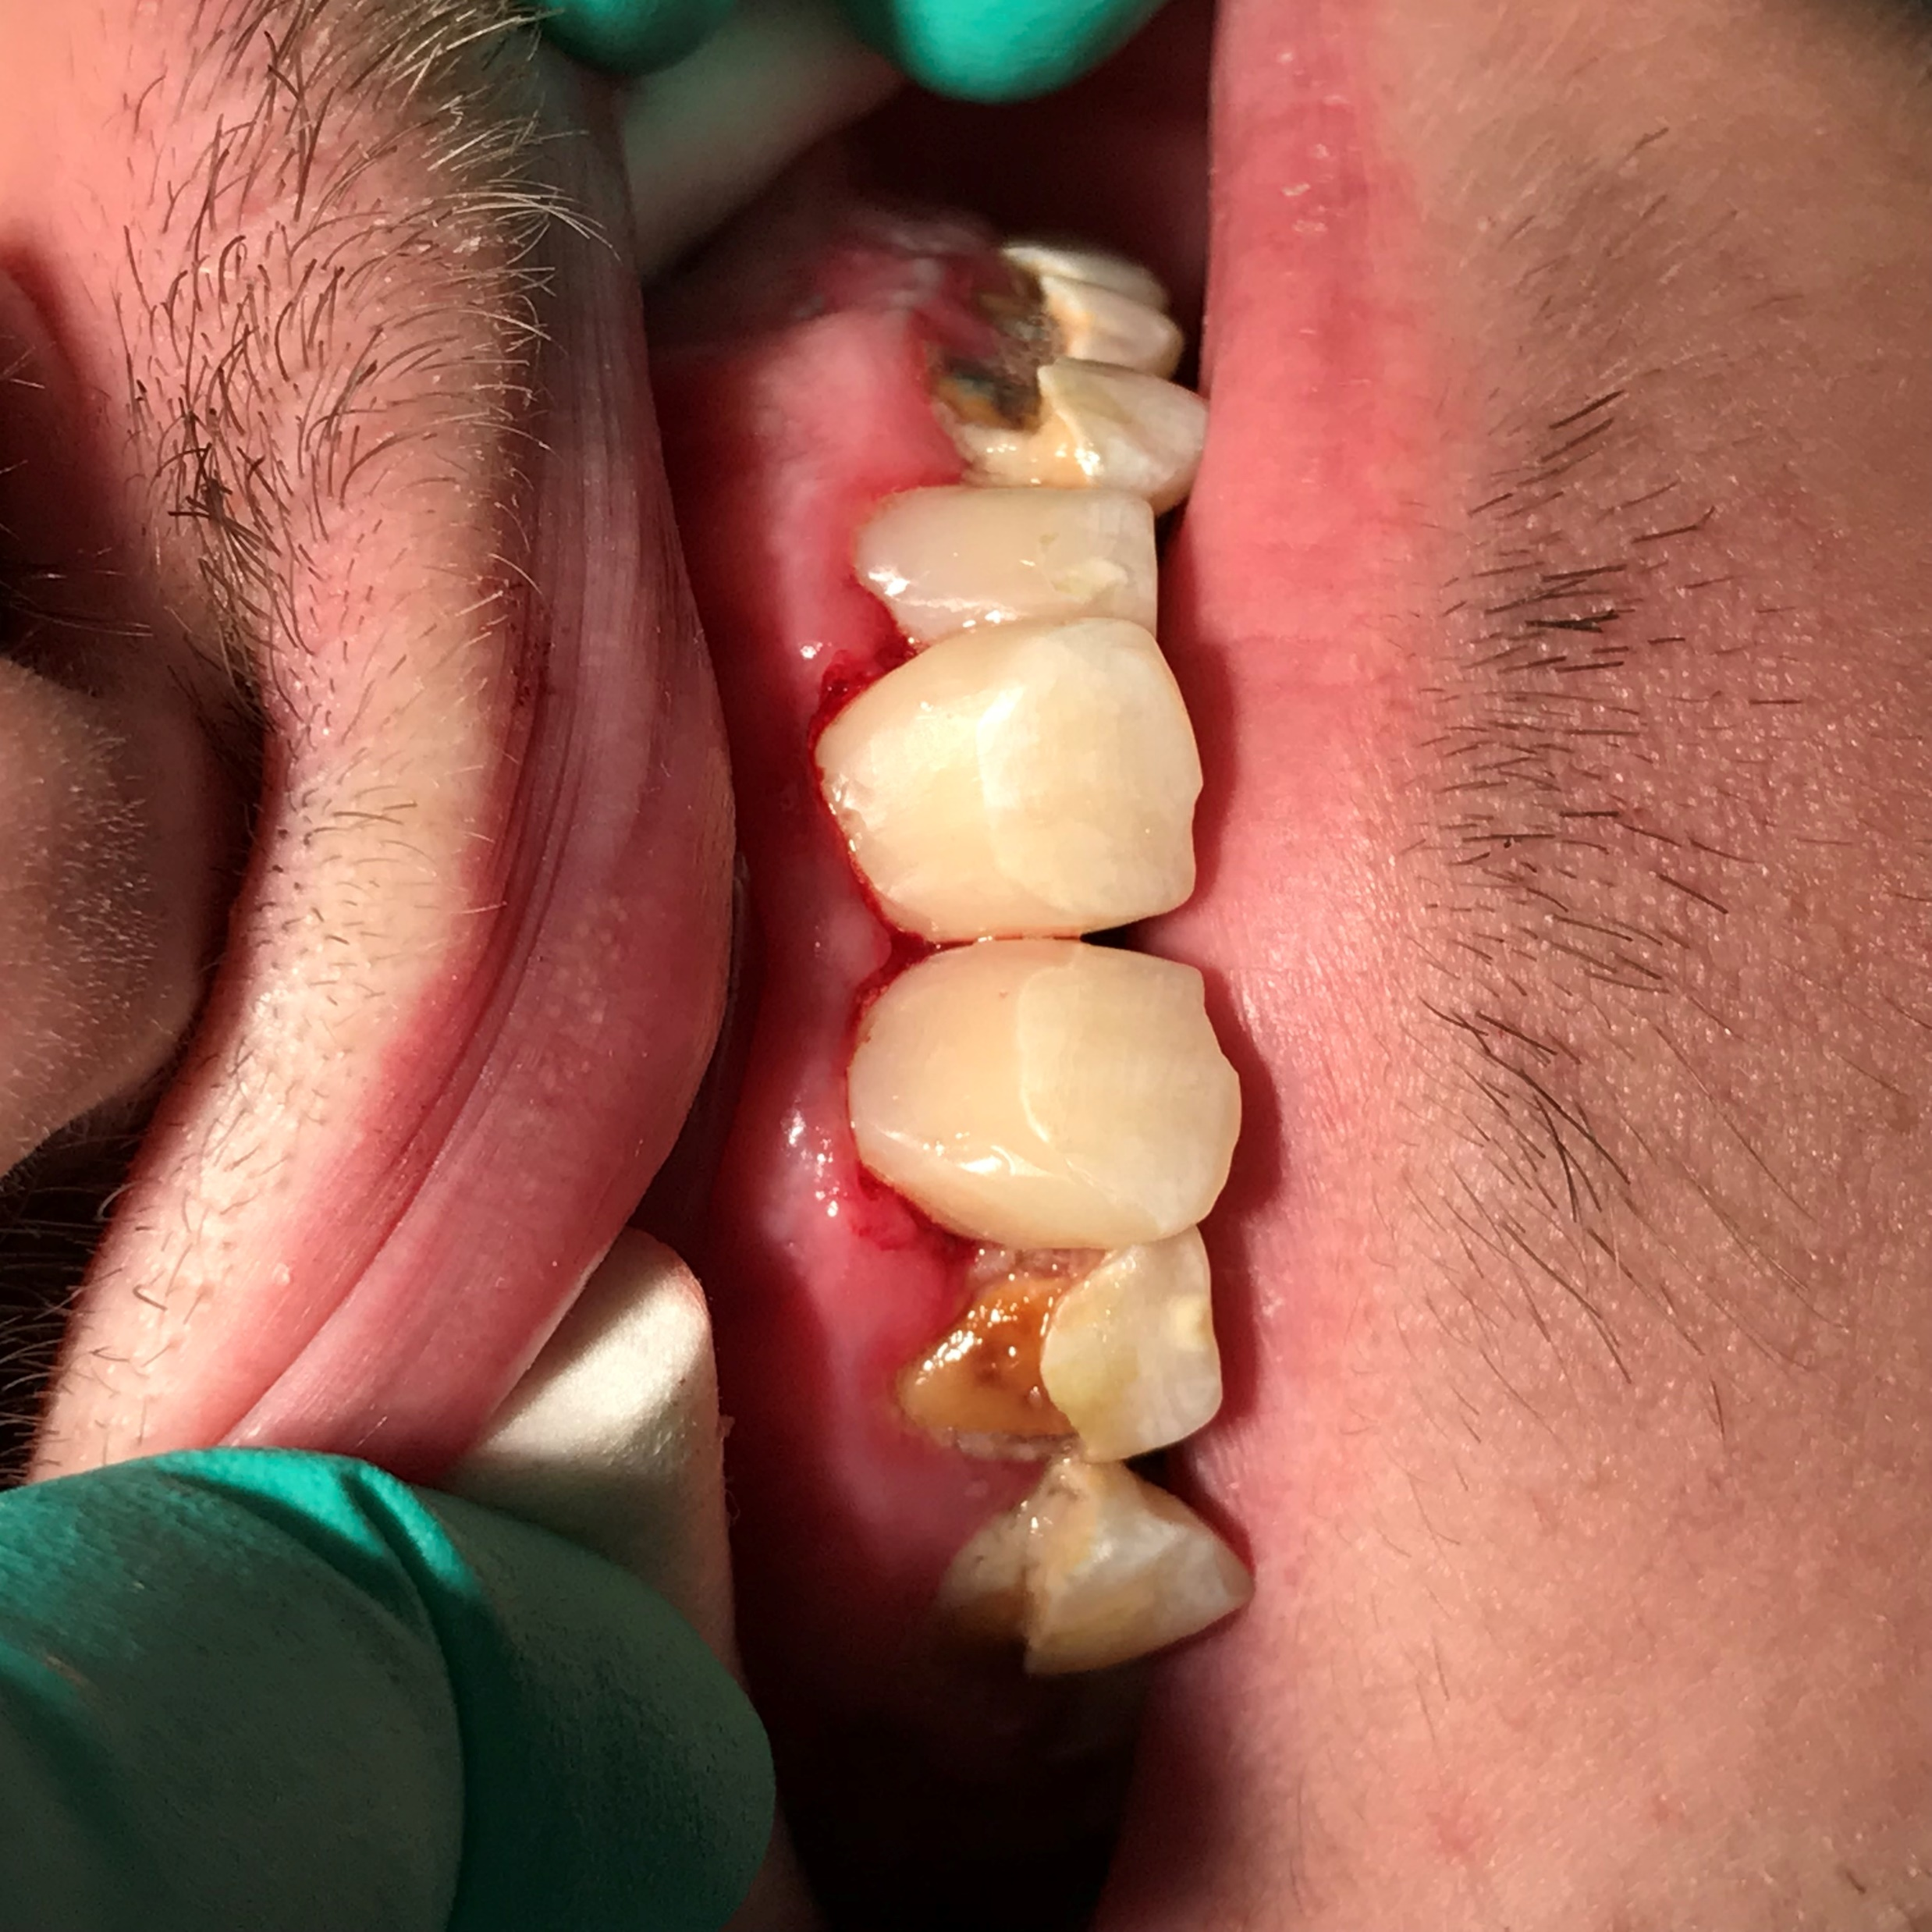
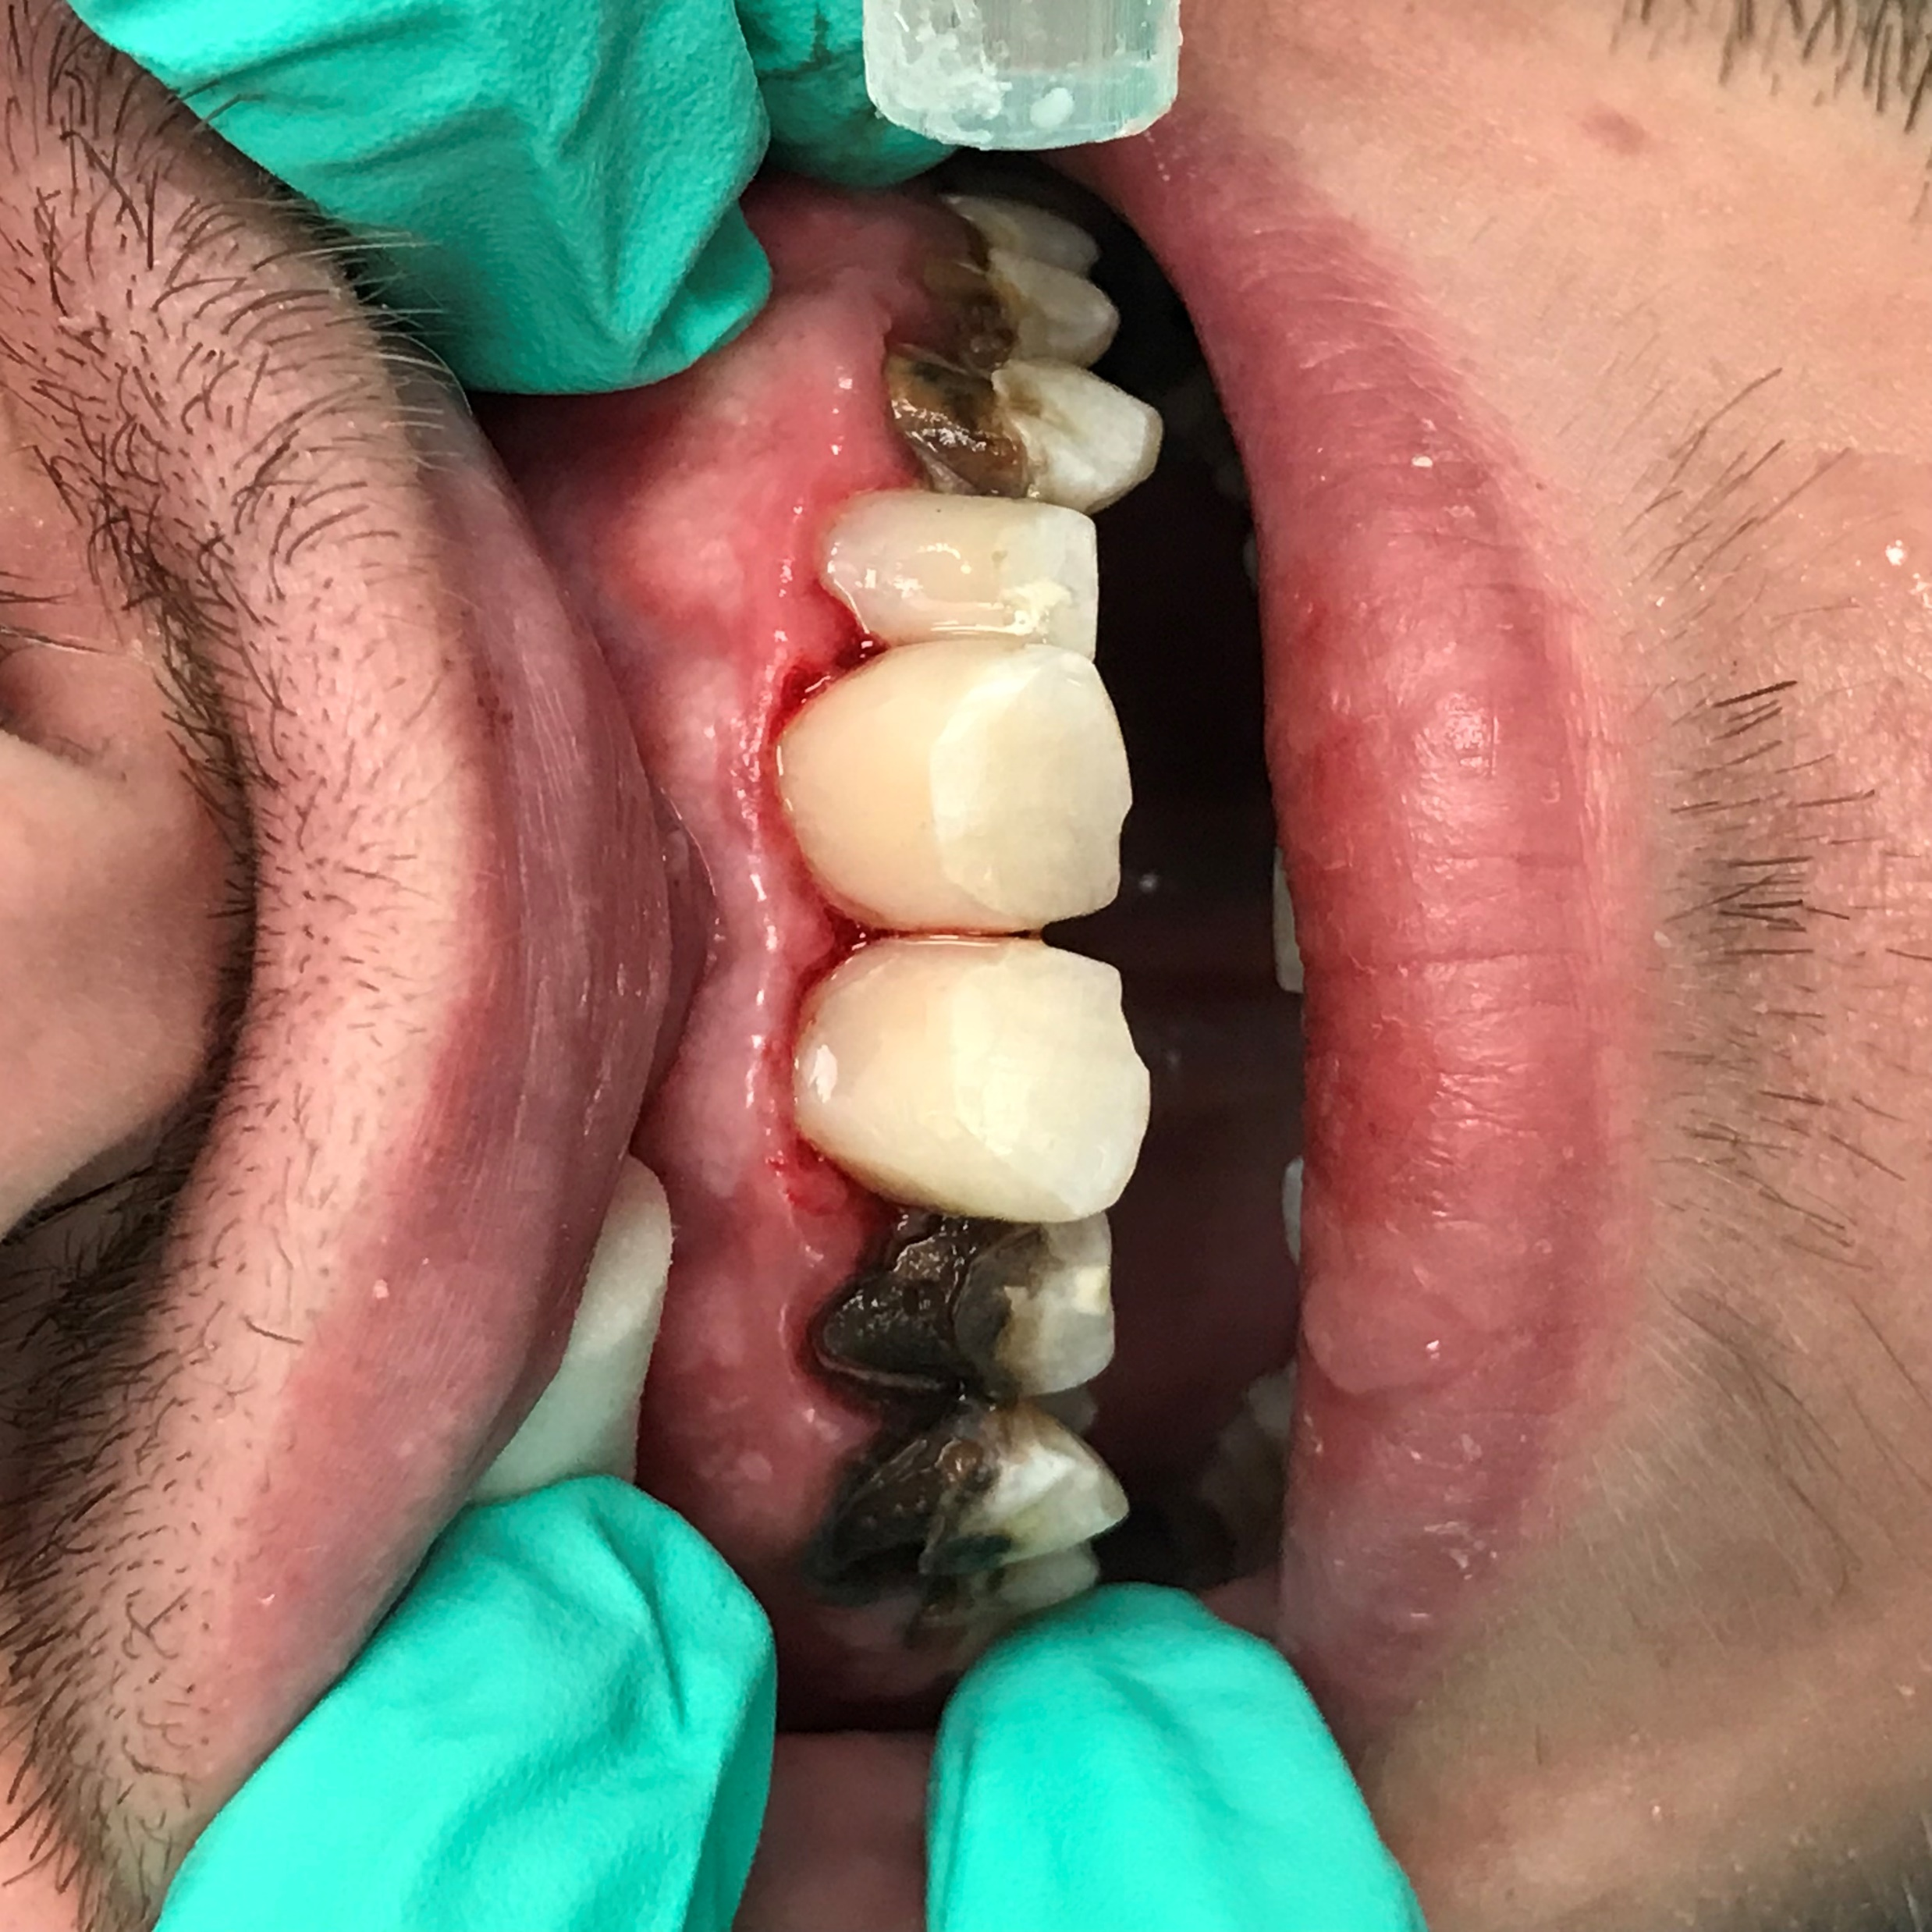
SDF in Action
M.O. Coover, DDS, MAGD

Slide 15
Indications:
1. Extreme caries risk (xerostomia or severe early childhood caries).
2. Treatment challenged by behavioral or medical management.
3. Patients with carious lesions that may not all be treated in one or two visits.
4. Difficult to treat dental carious lesions.
5. Patients without access to dental care.
6. Cervical hypersensitivity
No, it doesn’t stain non-carious teeth
M.O. Coover, DDS, MAGD

Slide 16
Maximum dose
Maximum dose: 25 μL (1 drop) / 10kg per treatment visit.
SDF Contraindication: Silver allergy.
SDF Relative Contra-indications: Ulcerative gingivitis, stomatitis.
SS-KI Contraindications: Pregnancy, breastfeeding.
M.O. Coover, DDS, MAGD

Slide 17
Considerations:
Decayed dentin will darken as the caries lesions arrest. Most will be dark brown or black.
SDF can stain the skin, which will clear in two to three weeks without treatment.
SDF can permanently stain operatory surfaces and clothes.
M.O. Coover, DDS, MAGD

Slide 18
Considerations:
• A provisional restoration (e.g., GI via ART or other material) may be considered after SDF treatment. [remember to rinse first]
• Saturated solution of potassium iodide (SS-KI, [not Lugol’s Solution] ) can be used after SDF to decrease color changes ( but not much).
• Re-application is usually recommended, biannually until the cavity is restored or arrested or the tooth exfoliates.

Slide 19
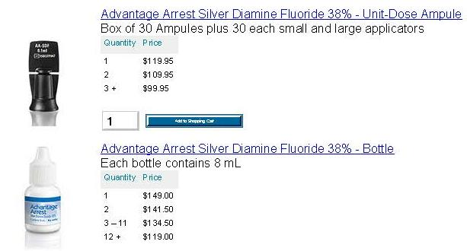
SDF Cost
8 ml is enough for 160 patients
M.O. Coover, DDS, MAGD

Slide 20
SDF Cost
Use 1 drop per patient
1 drop treats 3-5 sites
Bottle contains 8ml = 160 drops
$149 ÷ 160 = 93¢ per drop
M.O. Coover, DDS, MAGD

Slide 21
How to Get Paid
Code D1354: Interim caries arresting medicament application;
Code D1208: Topical application of fluoride;
Code D9910: Application of a desensitizing medicament, per visit; or
Code D1999: Unspecified preventive procedure by report.
You may have to identify your patient’s caries risk to justify reimbursement with a recognized caries risk tool. Codes D0601 (low risk), D0602 (moderate risk), D0603 (high risk) are especially helpful in all claims in order to measure the change in caries risk of the patients in your practice.
M.O. Coover, DDS, MAGD

Slide 22
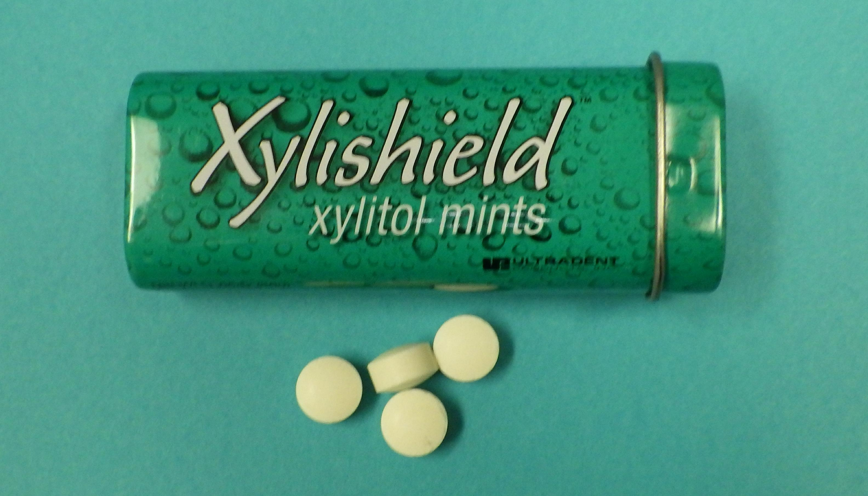
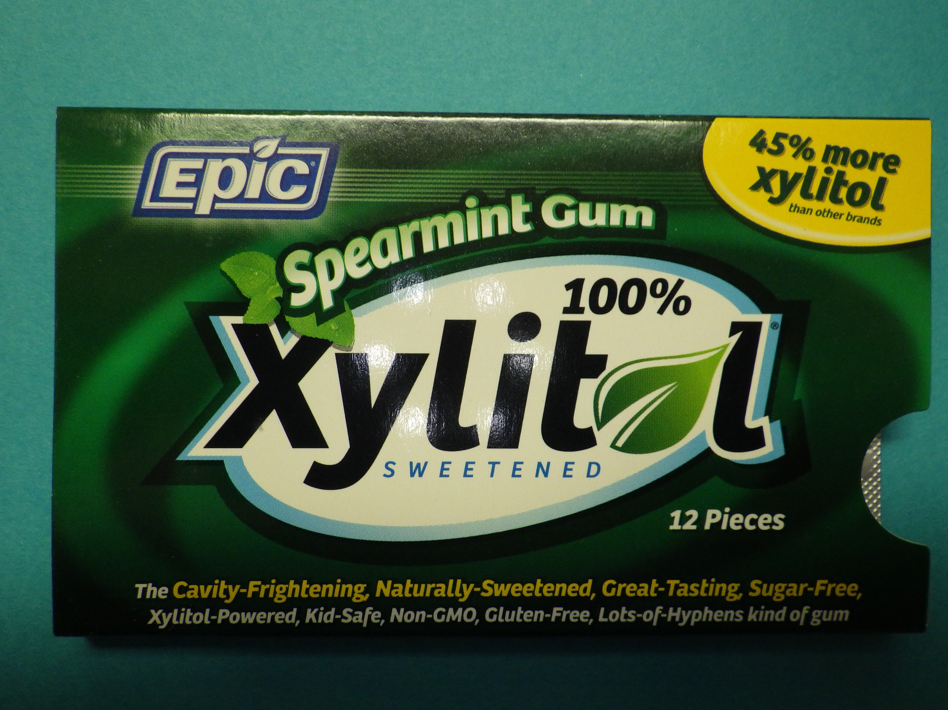
Xylitol

Slide 23
Xylitol
Five carbon sugar alcohol
Not fermentable by mutans strep.
Chew 2 gms for five minutes 3-5 times per day
“These results and previous studies suggest that high xylitol chewing
gum usage can retard or arrest even rampant dentine caries in conditions
where effective restoration and prevention programs have not been
instituted, and can also provide additional protection against further caries
development during full implementation of restorative procedures by
holding the lesion in a non-progressive condition.”
Makinen KK et al
1 Suppl 1
International Dental Journal 1995
M.O. Coover, DDS, MAGD

Slide 24
How does Xylitol work?
Starvation Effect
Environmental Effect
Adhesion Effect
M.O. Coover, DDS, MAGD

Slide 25
Starvation Effect
S. mutans readily absorbs xylitol
S. mutans cannot metabolize xylitol, the bacteria that have absorbed xylitol starve

Slide 26
Environmental Effect
S. mutans is acidophilic and acidogenic
As some of the S. mutans starve and die, the plaque biofilm becomes less acidic, less hospitable to acidophilic bacteria.
The biome slowly shifts to less cariogenic bacteria

Slide 27
Adhesion Effect
As the plaque biome shifts, the replacement bacteria, while still acidogenic, are less able to adhere to tooth surfaces long enough to foster demineralization and caries .

Slide 28
MAINTAINING MUTANS STREPTOCOCCI SUPPRESSION WITH XYLITOL CHEWING GUM
Subjects rinsed with 0.12 percent CHX gluconate mouthrinse twice daily for 14 days.
Those in the test group (n = 51) chewed a commercial xylitol gum three times daily for a minimum of five minutes each time for three months. The placebo group subjects (n = 50) used a commercial sorbitol gum, and the control group subjects (n = 50) did not chew gum.
Hildebrandt Gh, Sparks BS, J Am Dent Assoc, 2000; 131 (JUly): 909-916
M.O. Coover, DDS, MAGD
Notes:
Hildebrandt Gh, Sparks BS,

Slide 29
“At 3 months after CHX rinsing, mean MS levels increased
toward baseline but at different rates. The placebo group
increased 40-fold, the control group increased 25-fold, and
the test group had an 8-fold increase...”
Conclusion: The use of xylitol chewing gum significantly
delays the return of oral MS after therapeutic use
of a CHX mouthrinse.
Maintaining Mutans Streptococci Suppression
With Xylitol Chewing Gum
Maintaining Mutans Streptococci Suppression With Xylitol Chewing Gum
Hildebrandt Gh, Sparks BS, J Am Dent Assoc, 2000; 131 (JUly): 909-916
M.O. Coover, DDS, MAGD

Slide 30
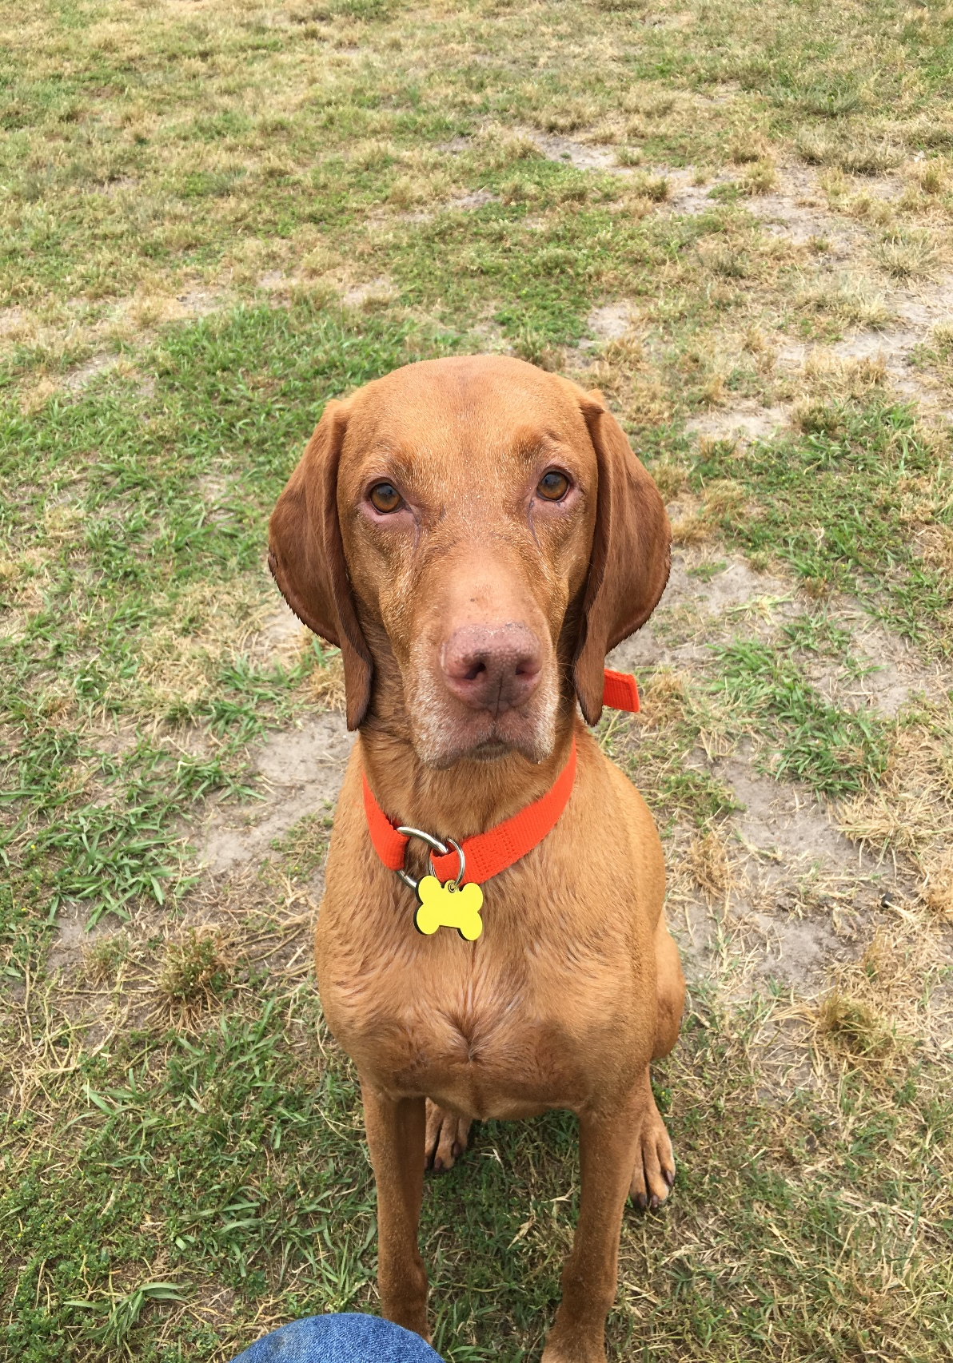
A Word about Dogs
GCH Geordi, CGC, CGC-U, CGC-A
M.O. Coover, DDS, MAGD

Slide 31
In humans, Xylitol is absorbed slowly and has no measurable effect on insulin production.
Unfortunately, the same cannot be said about dogs. When dogs eat Xylitol, their bodies mistakenly think that they’ve ingested a huge amount of glucose and start producing large amounts of insulin.
When this happen, the dog’s cells start rapidly taking up glucose from the bloodstream. This can lead to hypoglycemia (low blood sugar levels) and is fatal if not treated immediately.
Xylitol may also have detrimental effects on liver function in dogs, with high doses causing liver failure.
So if you own a dog, then keep Xylitol out of reach (or out of your house altogether). If you believe your dog accidentally ate Xylitol, take it to the vet immediately.
M.O. Coover, DDS, MAGD

Slide 32
Xylitol Occurs Naturally
Xylitol is found naturally in a number of fruits and vegetables (including strawberries, raspberries, pears, cauliflower and plums).
The human body produces between 5 and 15 grams of xylitol each day as it metabolizes carbohydrates. (It's an intermediate compound in the glucuronate-xyulose metabolic pathway.)
When manufactured, the starting agricultural product is usually birch trees or corn cobs.
M.O. Coover, DDS, MAGD

Slide 33
Xylitol Dosage
1) Six to ten grams per day.
2) Divided up into three to five doses throughout the day.
3) Continuation of this regimen for six months to a year before it can be assumed that maximum anti-cavity protection exists.

Slide 34
Dosage
The existence of a dosing ceiling was confirmed by a study [Milgrom, 2006] that evaluated different xylitol doses in regard to their ability to create changes in the level of cariogenic bacteria found in dental plaque and saliva.
Amounts exceeding 10.3 grams per day were not likely to increase effectiveness.
Doses of 3.5 grams or less per day were ineffective
2 pieces gum or mints, 3 tid = 6 grams

Slide 35

Dry Mouth
Biotene has long been used as a saliva substitute. It is useful during the day, especially in this spray form, but it does little at night.
Photo from Web

Slide 36
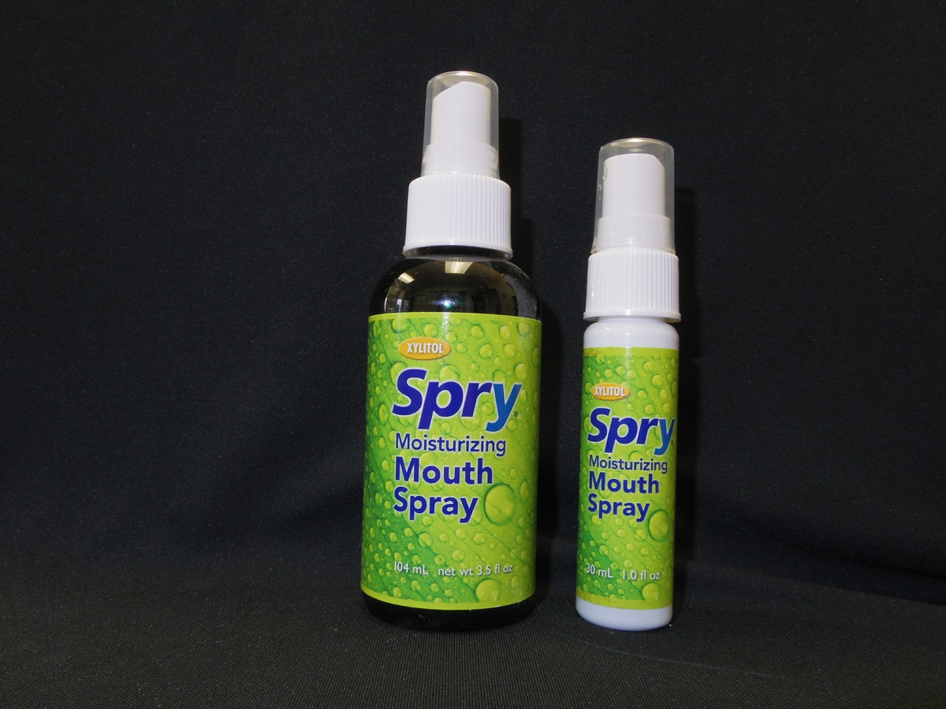
Dry Mouth
Spry makes a saliva substitute that contains xylitol.
Photo from Web

Slide 37
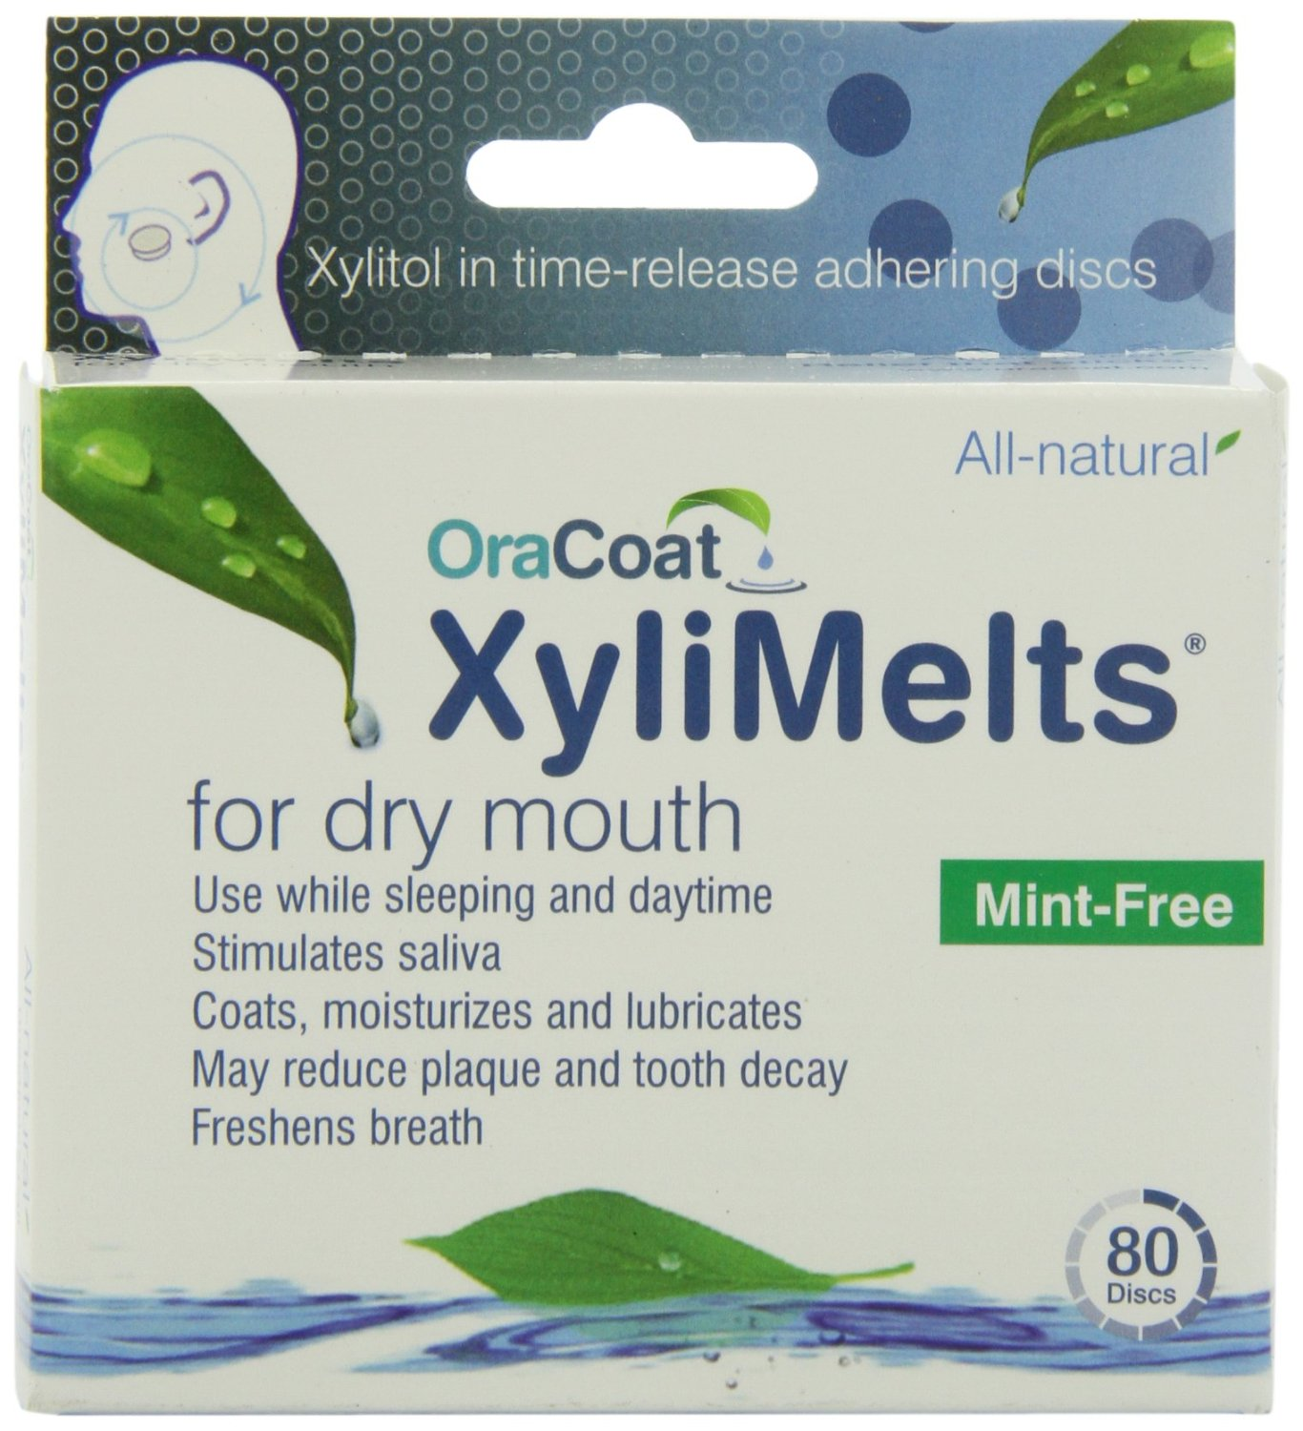
Dry Mouth
XyliMelts stimulate saliva production at night and also contain xylitol.
Photo from Web

Slide 38
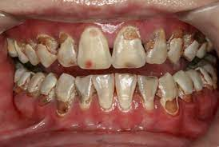
Anti-Microbials
Typically used only is cases of extreme rampant caries
Photo from Web

Slide 39
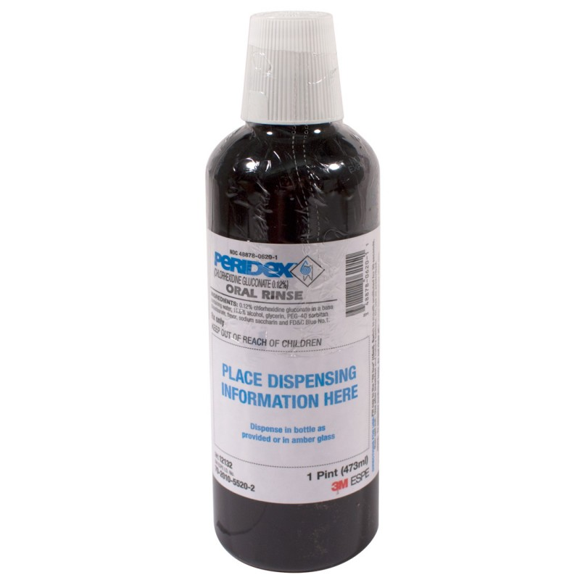
Chlorhexidine
Dosage for Caries control
Rinse with ½ ounce once per day for seven days. Repeat monthly.
One bottle lasts four months; rarely used beyond that.
Chlorhexidine binds to fluoride so use 2 hours before or two hours after brushing.
Photo from Web

Slide 40
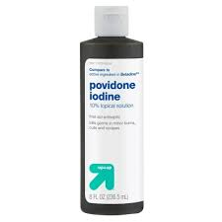
Povidone Iodine
Iodine is another anti-microbial used to re-set the oral microbiome to allow normal oral bacteria to re-populate the mouth. It is applied in-office once per week using a cotton-tip applicator to paint it on the teeth once a week for two weeks.
Brian Novi used it as a one-time rinse but this is very messy and patients don’t much like it.
Photo from Web

Slide 41
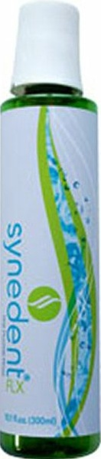
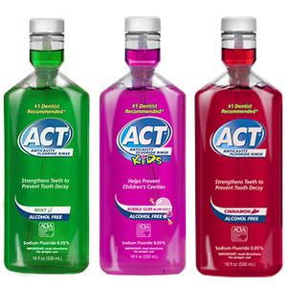
Fluoride Rinses
Fluoride Rinses are used mid-day after lunch, rinse vigorously and spit.
Synedent fluoride is available from Amazon.com. It contains 250 ppm fluoride, chitosan-argininamide. Arginine is metabolized to NH4 by oral bacteria thus raising the oral pH. This is currently not on the market.
ACT is available in any drug or grocery store. 250 ppm fluoride
Photo from Web

Slide 42
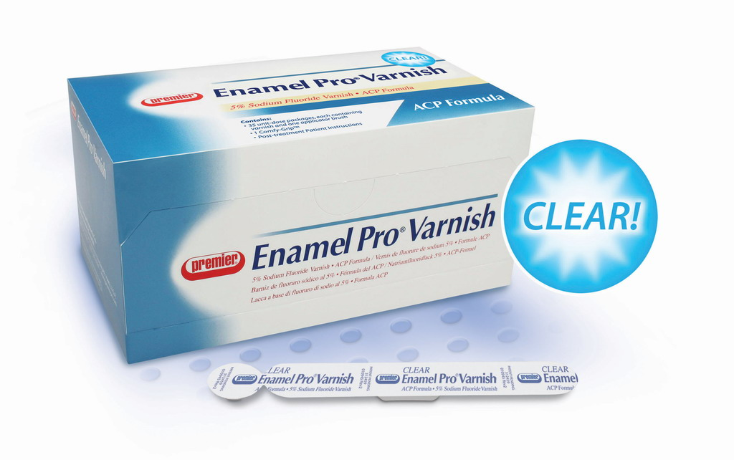
Fluoride Varnish
Moderate and High-Risk patients should have fluoride varnish applied to the teeth at every prophy.
Photo from Web

Slide 43
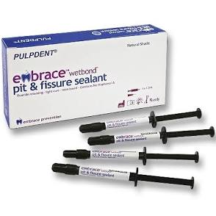
Pit & Fissure Sealants
90% retention at 10 years (if done correctly)
Correct bonding and isolation are critical
Biofilm removal
Etch
Prime
Bond
Apply sealant sparingly
Insurance will not cover sealants in adults unless there is proof that patient is High Caries Risk
Always do a Caries Risk Assessment
Photo from Web

Slide 44
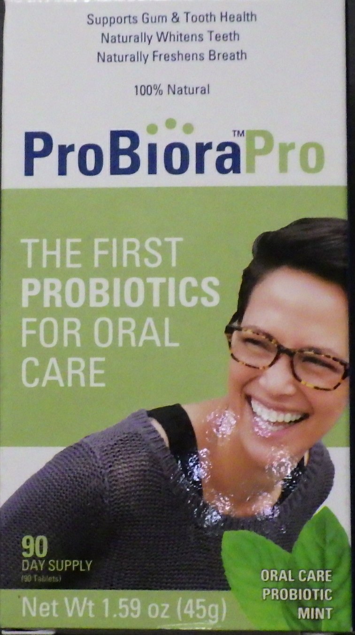
Probiotics
This particular pro-biotic has been developed by dentists (Dr. Jeffery Hillman) to re-populate the mouth with “normal” oral bacteria to change the biome of disease to one approaching normal.
Dr. Dan Sneed was an early proponent and owned stock in the company that developed it.
Photo from Web

Slide 45
Patient Recall Interval
Low Risk – every 6 months
Moderate Risk – every 4-6 months
High Risk – every 3-4 months
Extreme Risk – every 2-4 months

Slide 46
References
Caries Management by Risk Assessment: Implementation Guidelines douglas a. young, dds, ms, mba; john d.b. featherstone, msc, phd; jon r. roth, ms, cae; max anderson, dds, ms, med; jaana autio-gold, dds, phd; gordon j. christensen, dds, msd, phd; margherita fontana, dds, phd; v. kim kutsch, dmd; mathilde (tilly) c. peters, dmd, phd; richard j. simonsen, dds, ms; and mark s. wolff, dds, phd
Curing the Silent Epidemic: Caries Management in the 21st Century and Beyond. DOUGLAS A. YOUNG, DDS, MS, MBA; JOHN D.B. FEATHERSTONE, MSC, PHD; AND JON R. ROTH, MS, CAE
Nonrestorative Treatments for Caries: Systematic Review and Network Meta-analysis. O. Urquhart1 , M.P. Tampi1, L. Pilcher1, R.L. Slayton2, M.W.B. Araujo3, M. Fontana4, S. Guzmán-Armstrong5, M.M. Nascimento6, B.B. Nový7, N. Tinanoff 8, R.J. Weyant9, M.S. Wolff10, D.A. Young11, D.T. Zero12, R. Brignardello-Petersen13, L. Banfield14, A. Parikh15, G. Joshi16, and A. Carrasco-Labra1,17
Understanding Dental Caries, From Pathogenesis to Prevention and Therapy. Michel Goldberg, editor. ISBN 978-3-319-30550-9
A Randomized Clinical Trial of Anticaries Therapies Targeted according to Risk Assessment (Caries Management by Risk Assessment). J.D.B. Featherstone J.M. White C.I. Hoover M. Rapozo-Hilo J.A. Weintraub R.S. Wilson L. Zhan S.A. Gansky

Slide 47
The End

